Slide 1

Exploratory Data Analysis on Global Data Science Job Postings
Valencia, November 2024
by Alejandro Martínez Ruiz

Slide 2

Introduction & Objectives: Quantis Intelligence EDA
Key Objectives
Project Overview
Exploratory Data Analysis on global Data Science job postings for Quantis Intelligence.
Analyse salary trends across US, UK, and Asia
Identify most in-demand Data Science skills
Aim: Determine optimal location for new Data Science department.
Provide cost-benefit insights for hiring focus
Explore remote vs onsite job offerings
Focus: Job opportunities, salary trends, and required skills.

Slide 3
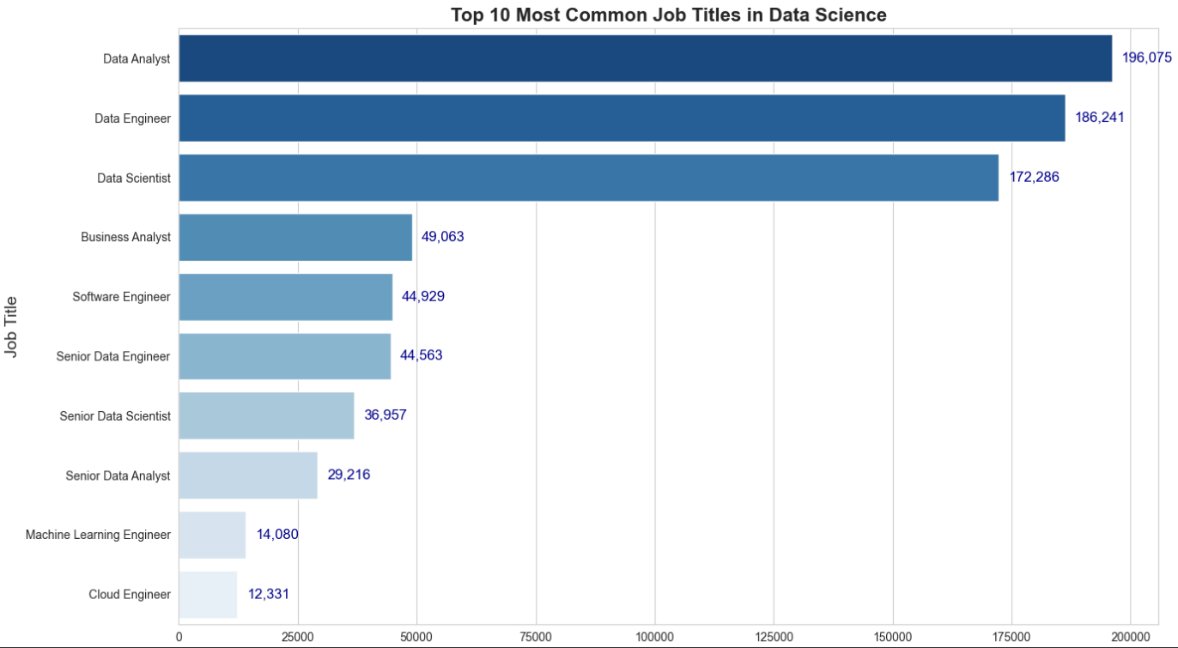
Data Overview

Slide 4
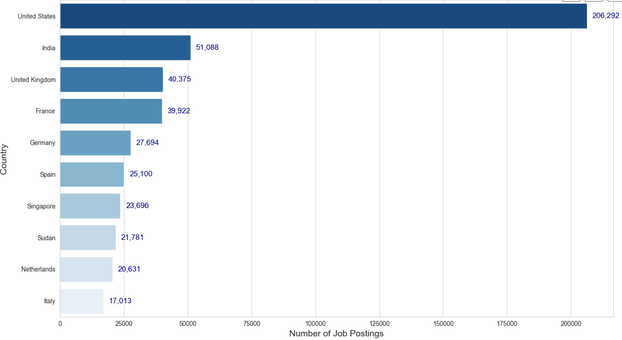
Top 10 Countries with Data Science Job Postings
Leading Countries
Emerging Markets
World map
USA, India, UK dominate job market
Brazil, Singapore show rapid growth

Slide 5
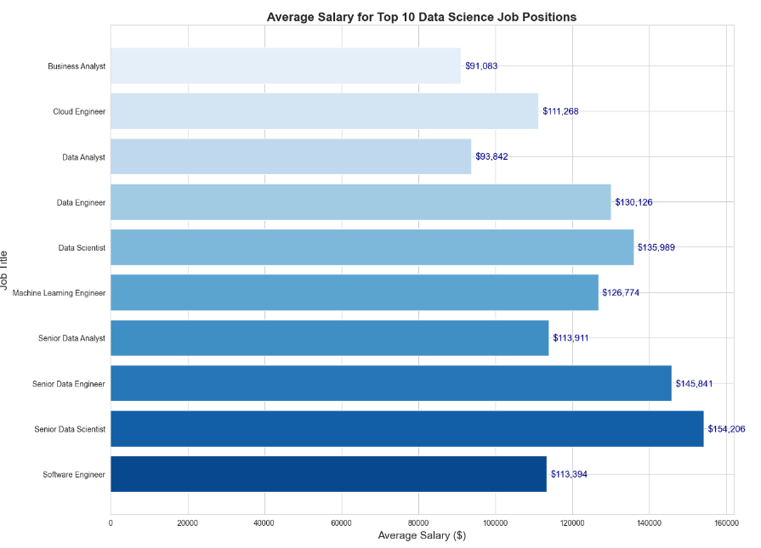
Salary Comparison for Top 10 Data Science Job Positions.

Slide 6

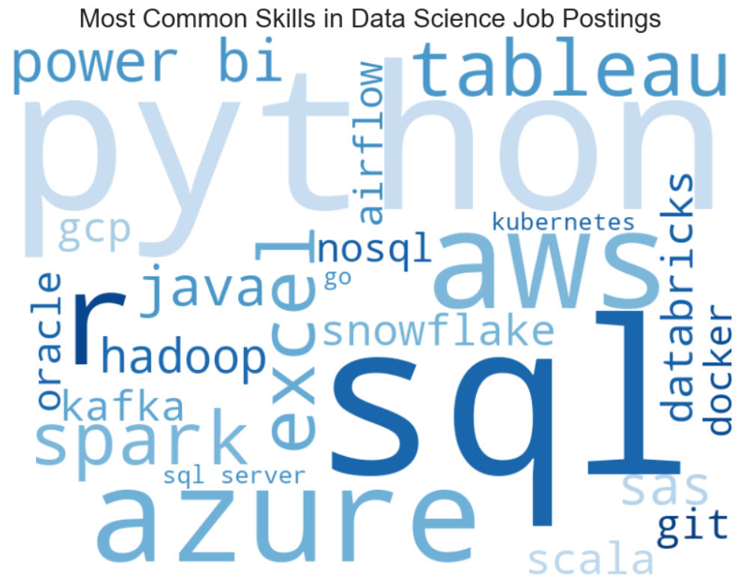
Top 10 Most In-Demand Skills for Data Science

Slide 7

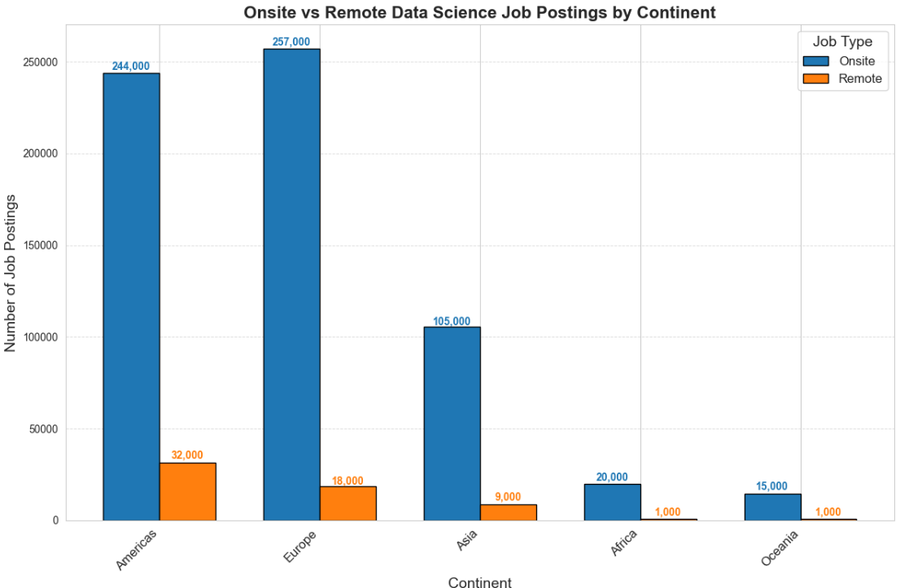
Remote vs Onsite Job Opportunities

Slide 8

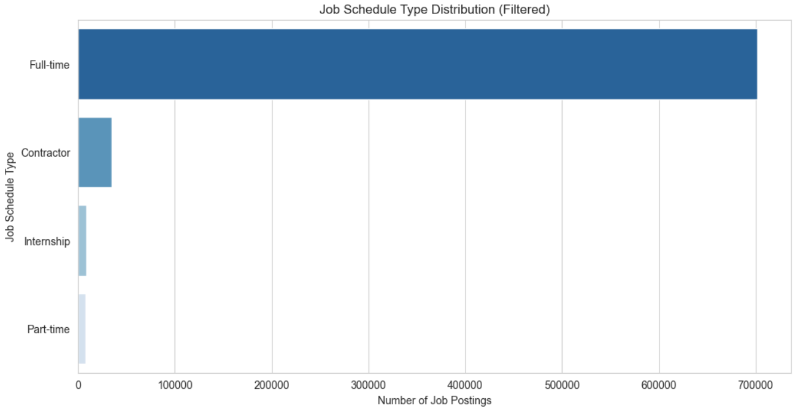
Job Schedule Type Distribution

Slide 9
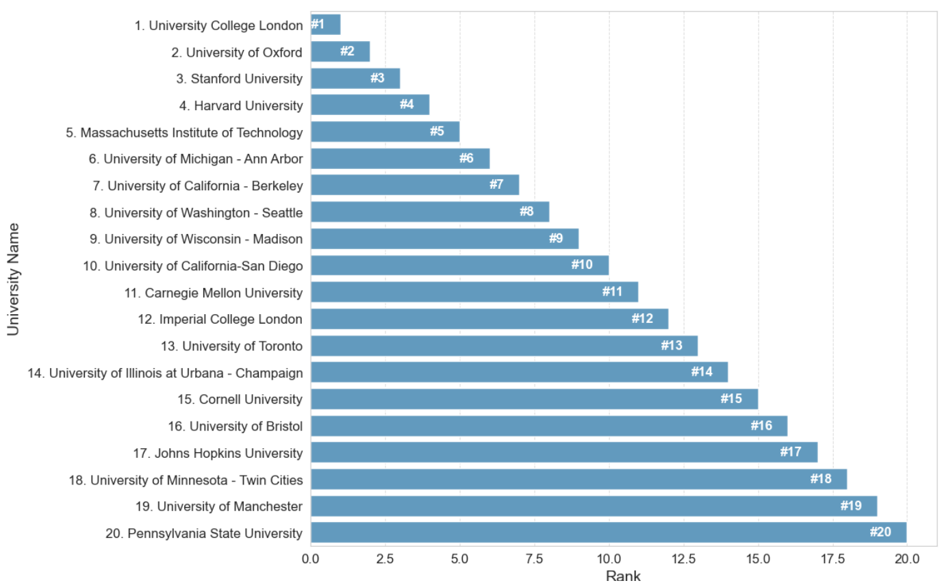
Top 20 Universities for Data Science
Source: EduRank.org

Slide 10
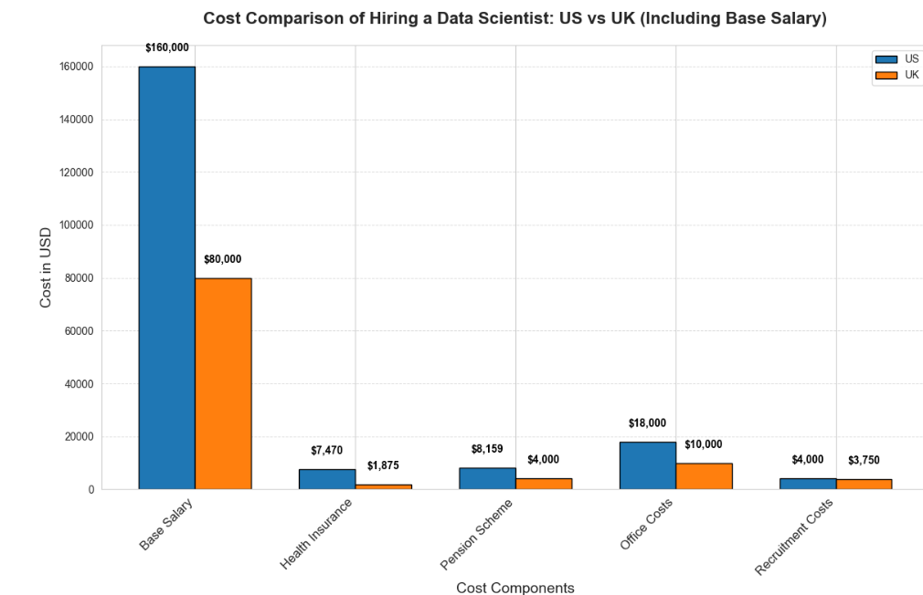
US vs UK: Base Salary & Other Costs

Slide 11




US vs UK: Conclusions
Office Space
US significantly higher than UK.
Recruitment
Similar costs, UK slightly lower.
Overall
UK expansion more budget-friendly.

Slide 12
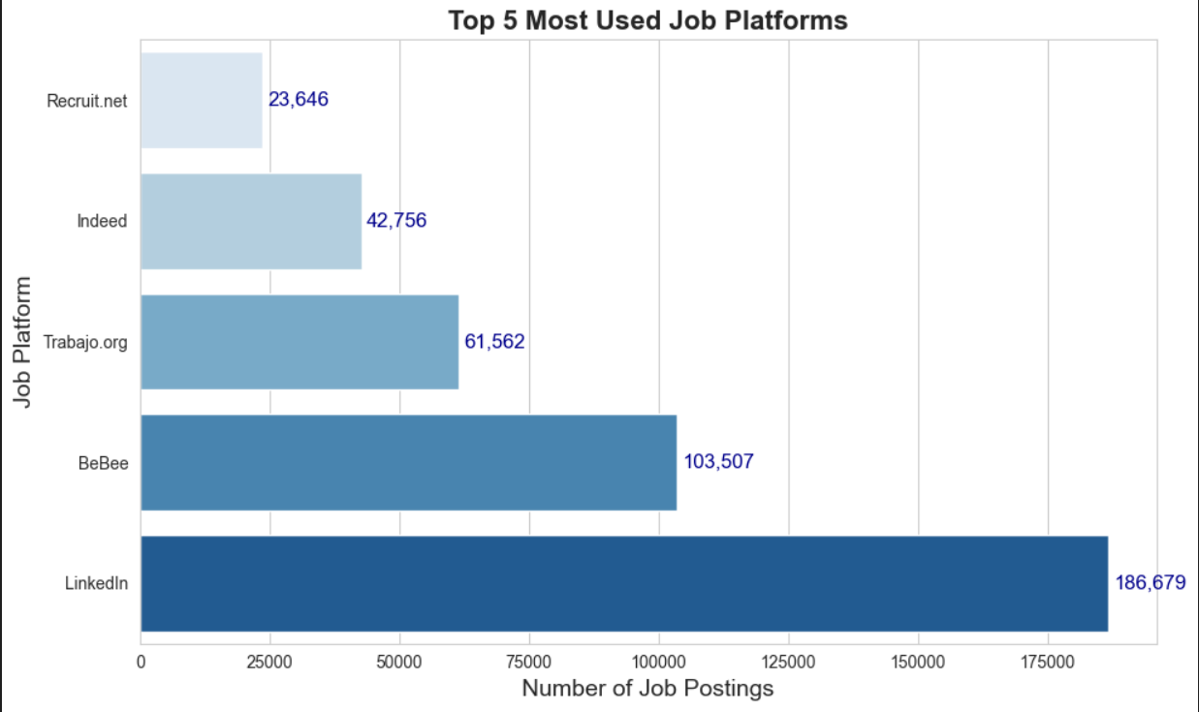
Top Job Platforms for Data Science Job Postings

Slide 13

Top Job Platforms for Data Science
1
LinkedIn
2
Bebee
Focus on personal branding.
Mostly used in Spanish speaking countries
Highest reach for professional networking.
Trabajo.org
4
Indeed
3
Listings and job opportunities for Spanish Speakers
One of the largest and most popular job search platforms

Slide 14




Key Findings
Salary Disparities
UK Cost-Efficiency
Critical Skills
US higher, but increased associated costs.
Balanced approach to hiring and benefits.
Python, SQL, Machine Learning in high demand.

Slide 15
Data Science Hiring: UK vs US Market Analysis
UK Advantages
US Landscape
Hiring Strategy
Lower salary expectations for data scientists. Reduced office costs compared to US counterparts.
Competitive market with higher number of top universities. Potentially more experienced talent available.
Consider onsite hiring due to limited remote job postings. UK could offer cost-effective expansion opportunities.
Strong concentration of top universities, indicating high-quality talent pool.
Higher costs associated with salaries and office space.
Evaluate trade-offs between cost savings and access to experienced talent.

Slide 16





Thank You for Your Participation
Q&A Session
Opportunity to address your queries.
Feedback Welcome
Your insights help us improve.
Sincere Appreciation
Your attendance made this event successful.

